Slide 1
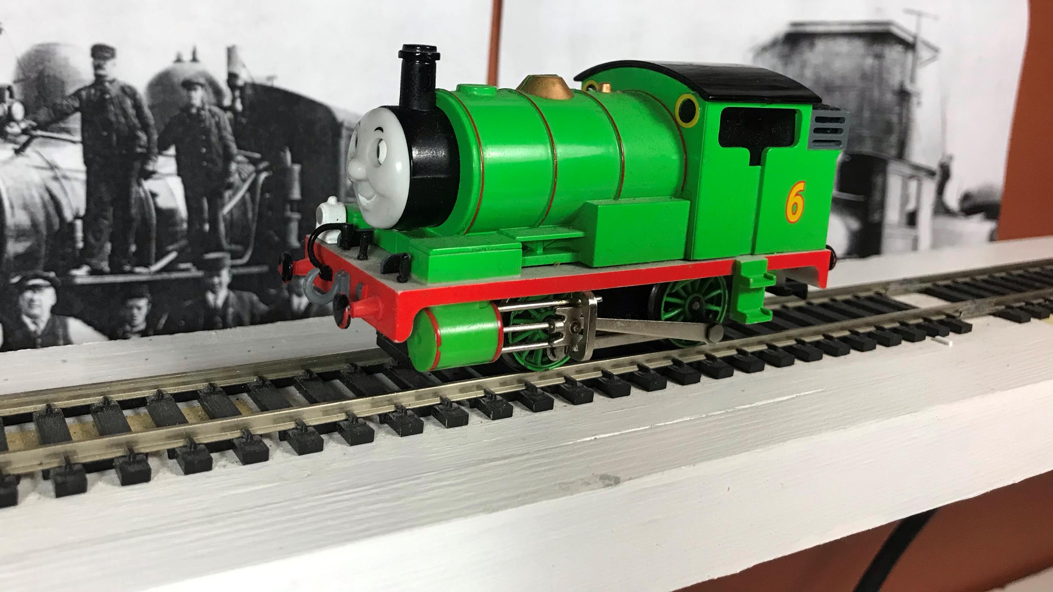
Learning from Percy
Rene Gourley
2022-01-19

Slide 2
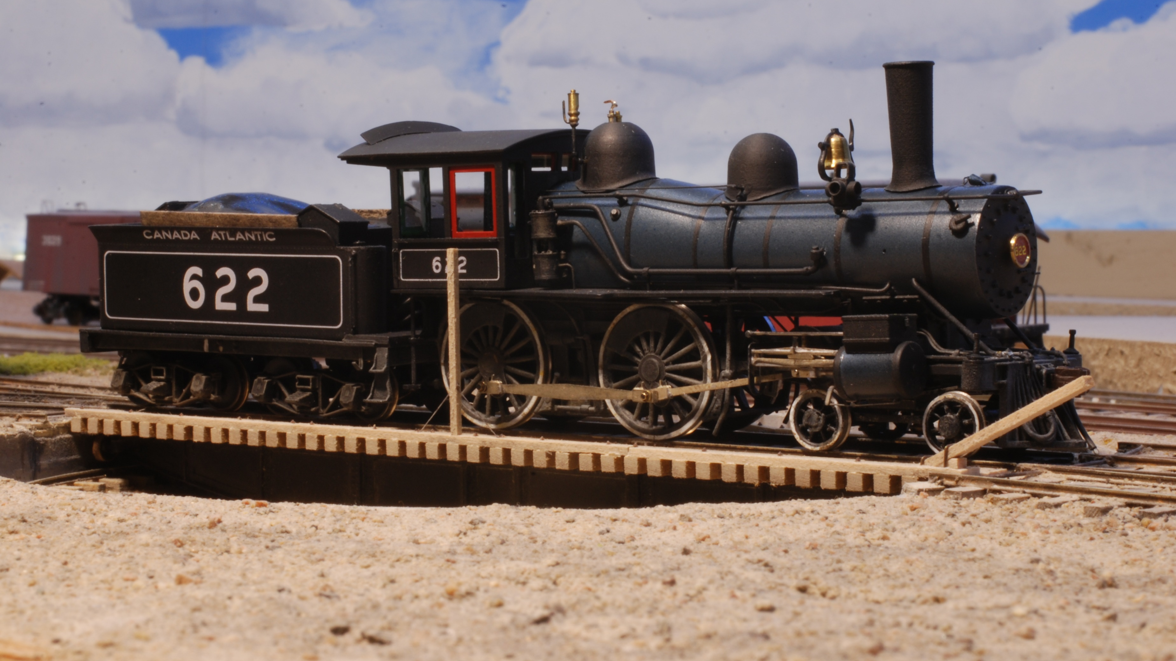

Slide 3
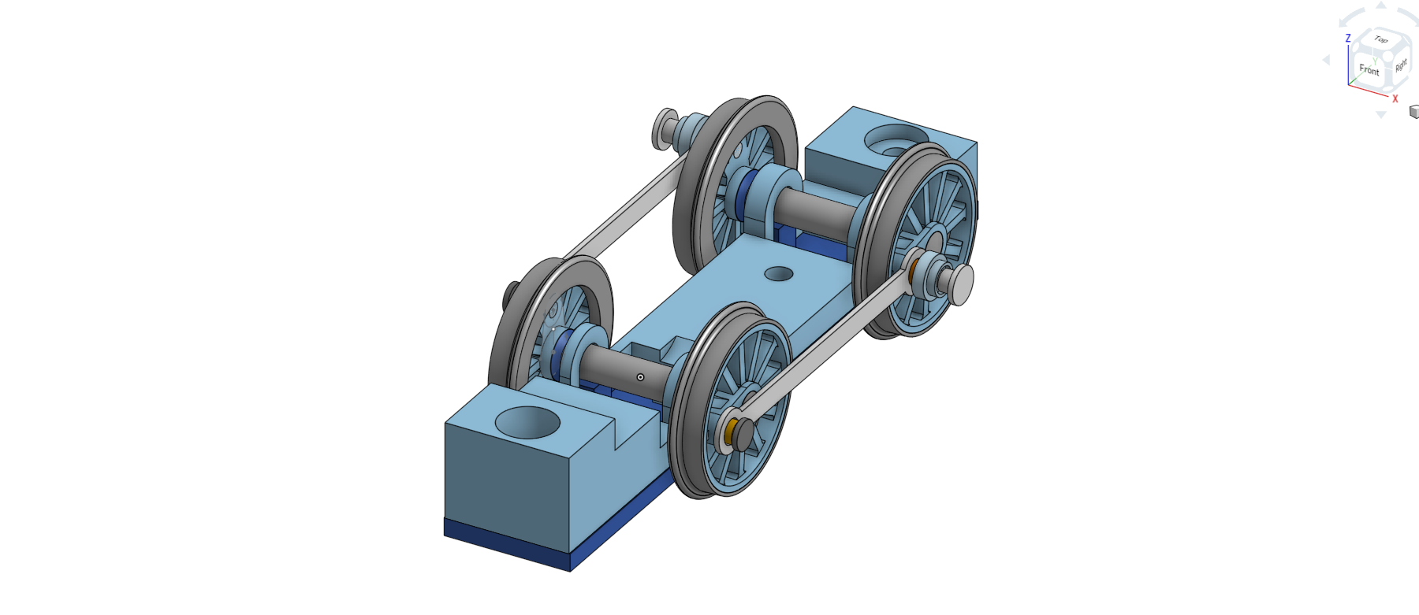

Slide 4
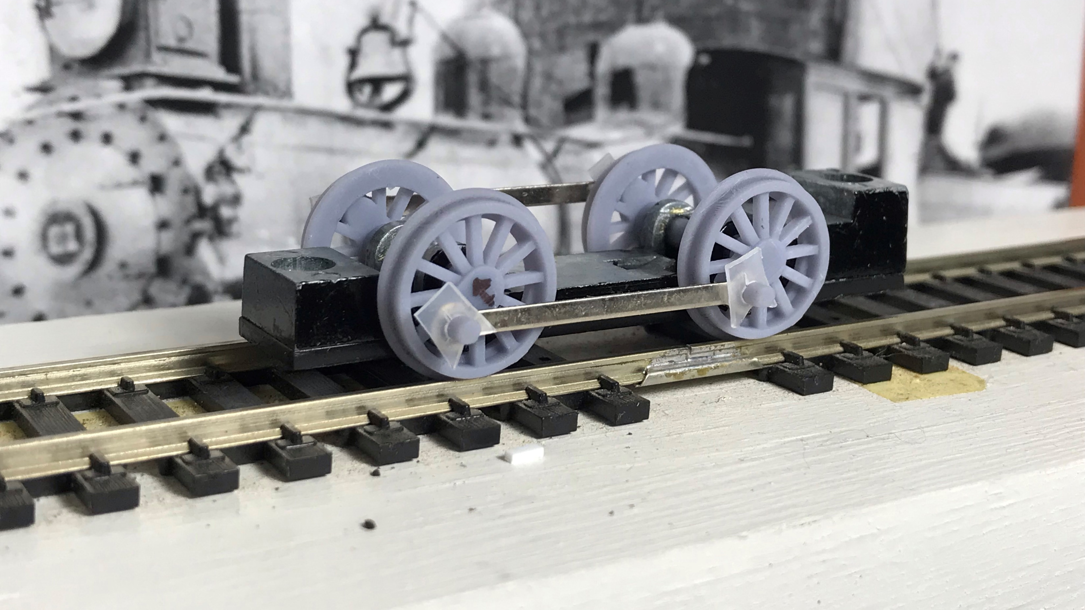

Slide 5
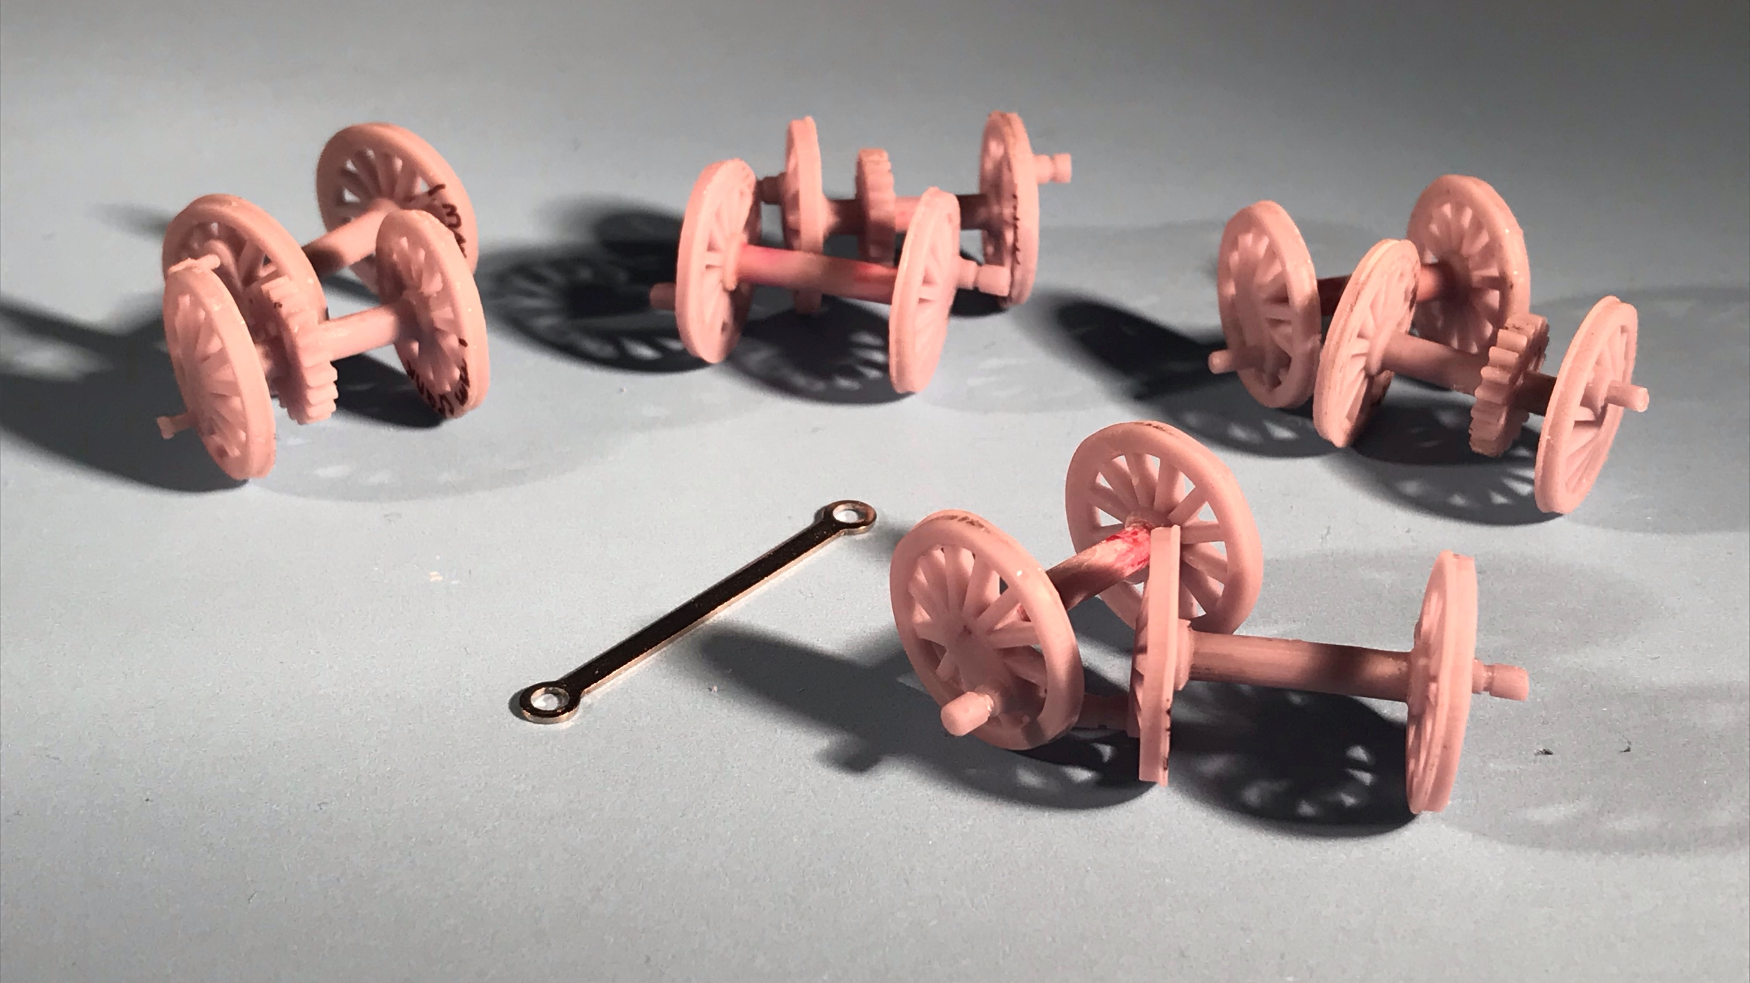

Slide 6
Fixed Experiments
Crankpin clearance
Hardly matters at all!
Out-of quarter
Up to +/-8 degrees
Eccentricity
Up to .022”
Crankpin size
No effect on out of-quarter or eccentricity tolerance.
Compensation
Magnifies any roughness

Slide 7
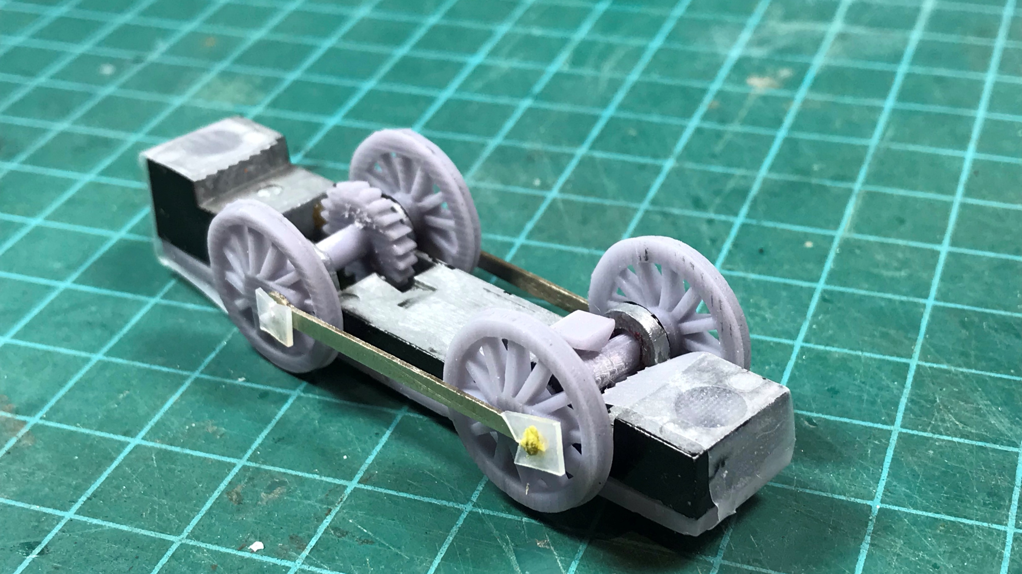

Slide 8
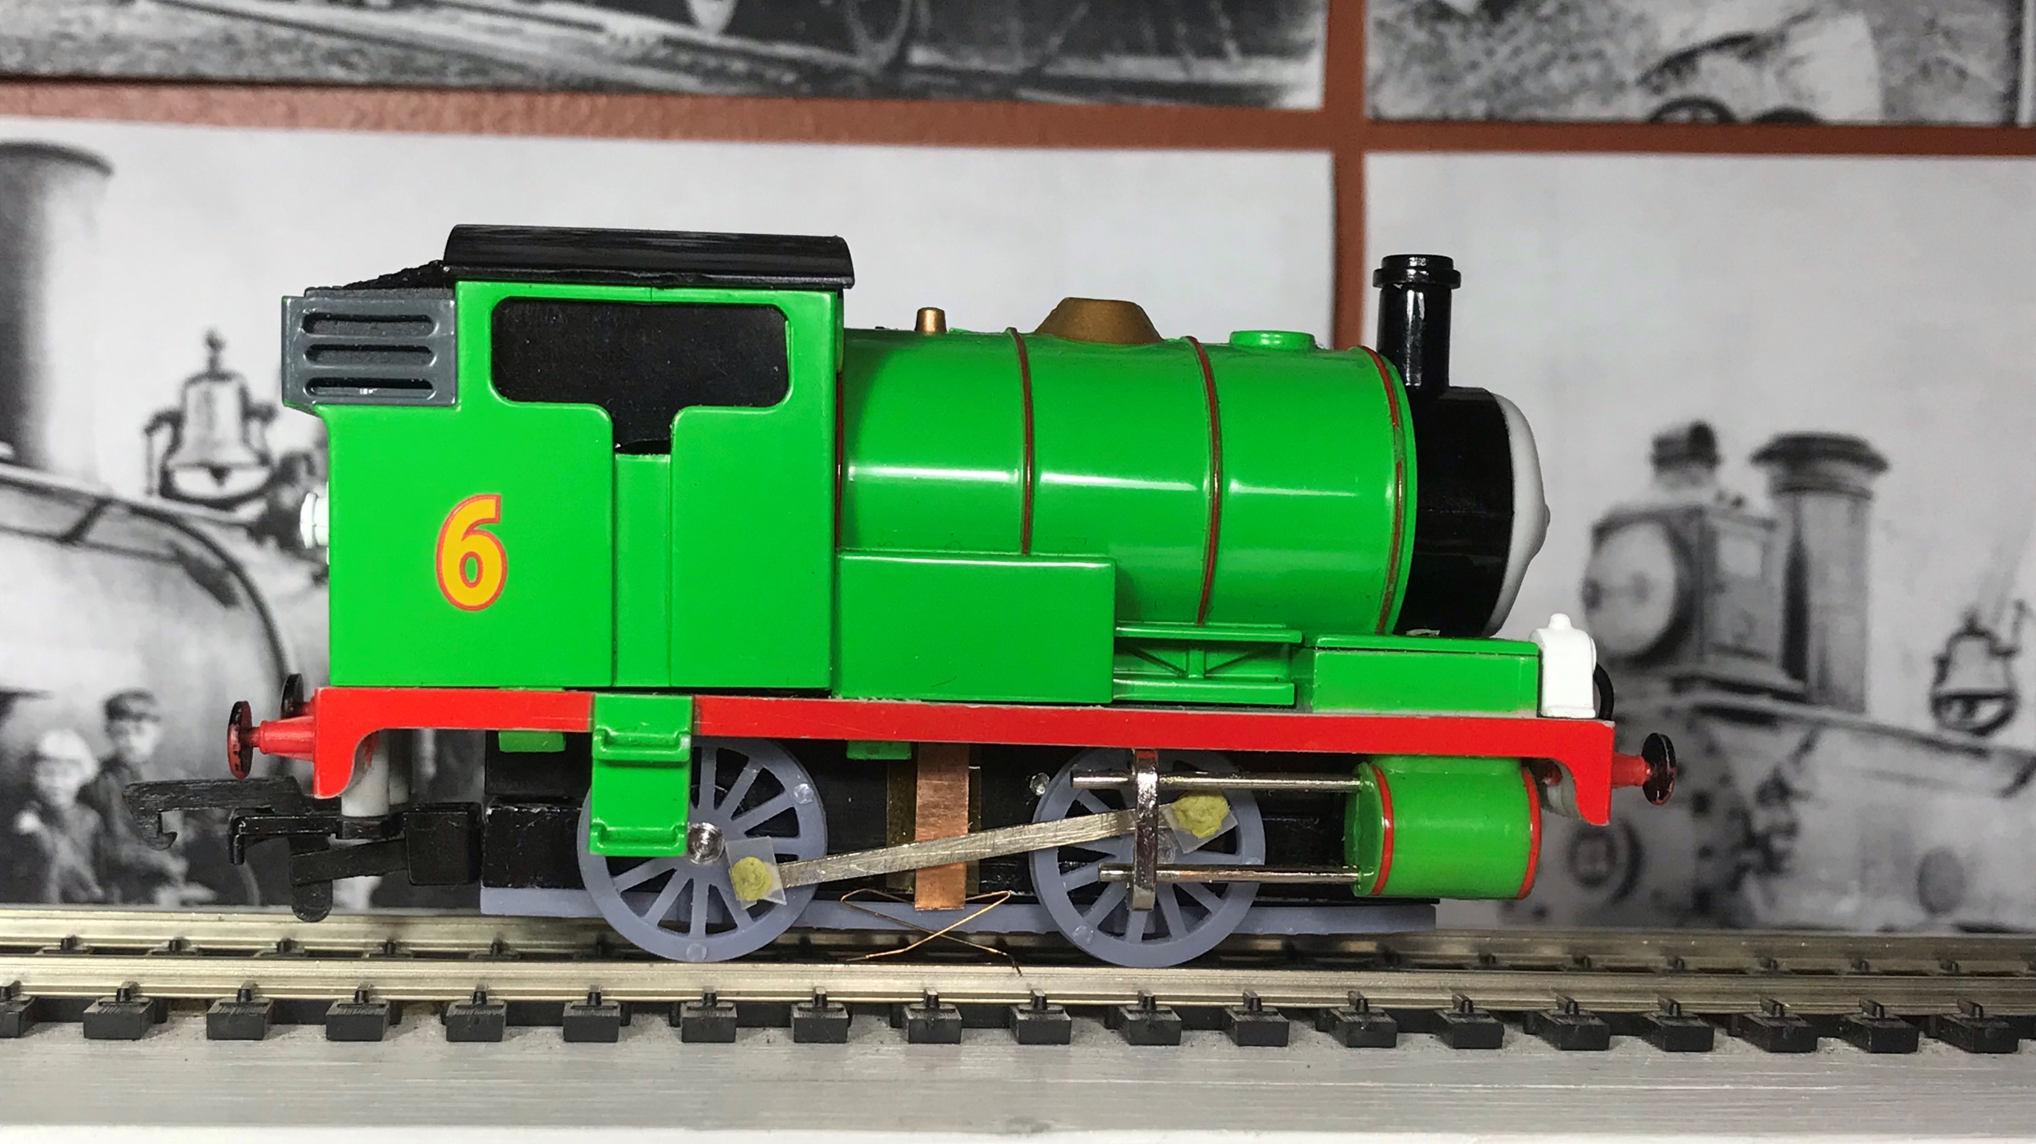

Slide 9
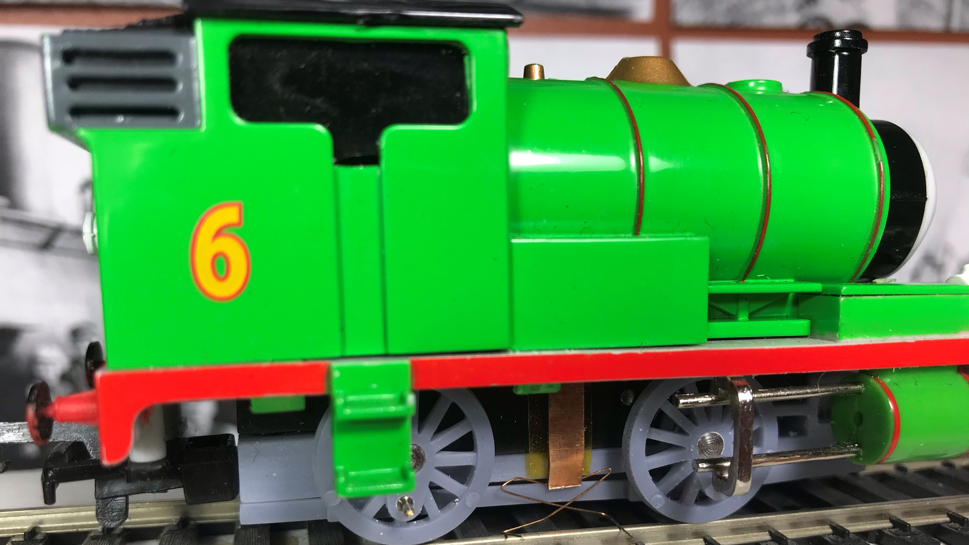

Slide 10
Loose Experiments
Loose drivers
Actually correct themselves!
Friction with frame
Takes slightly longer to correct

Slide 11
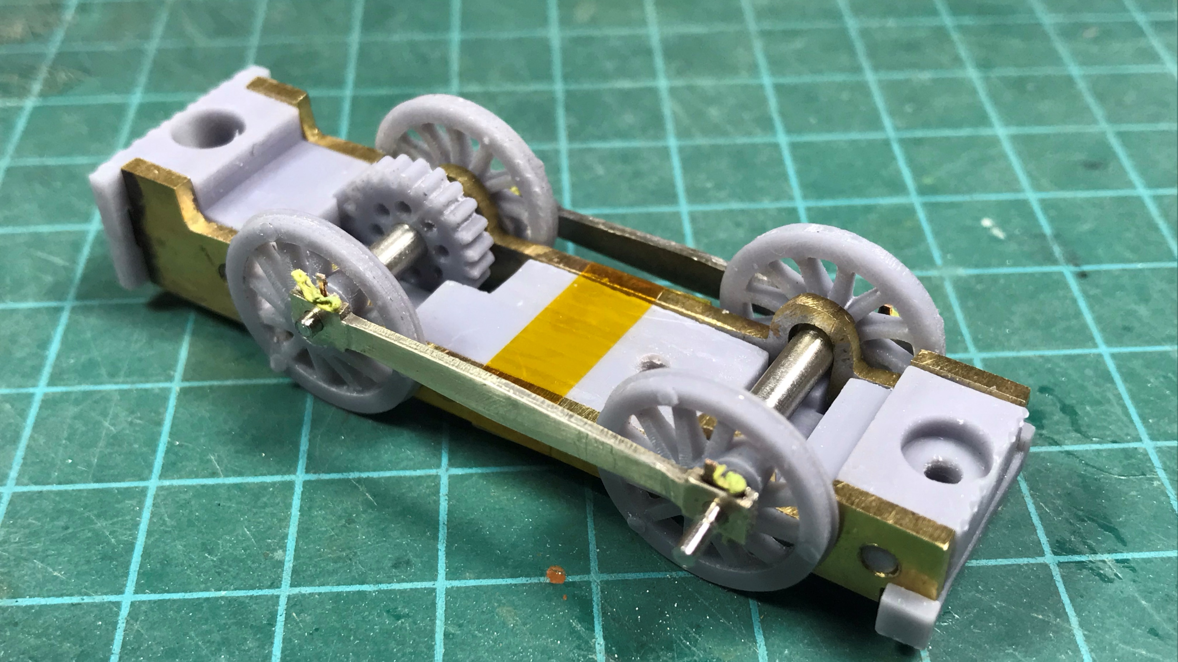

Slide 12
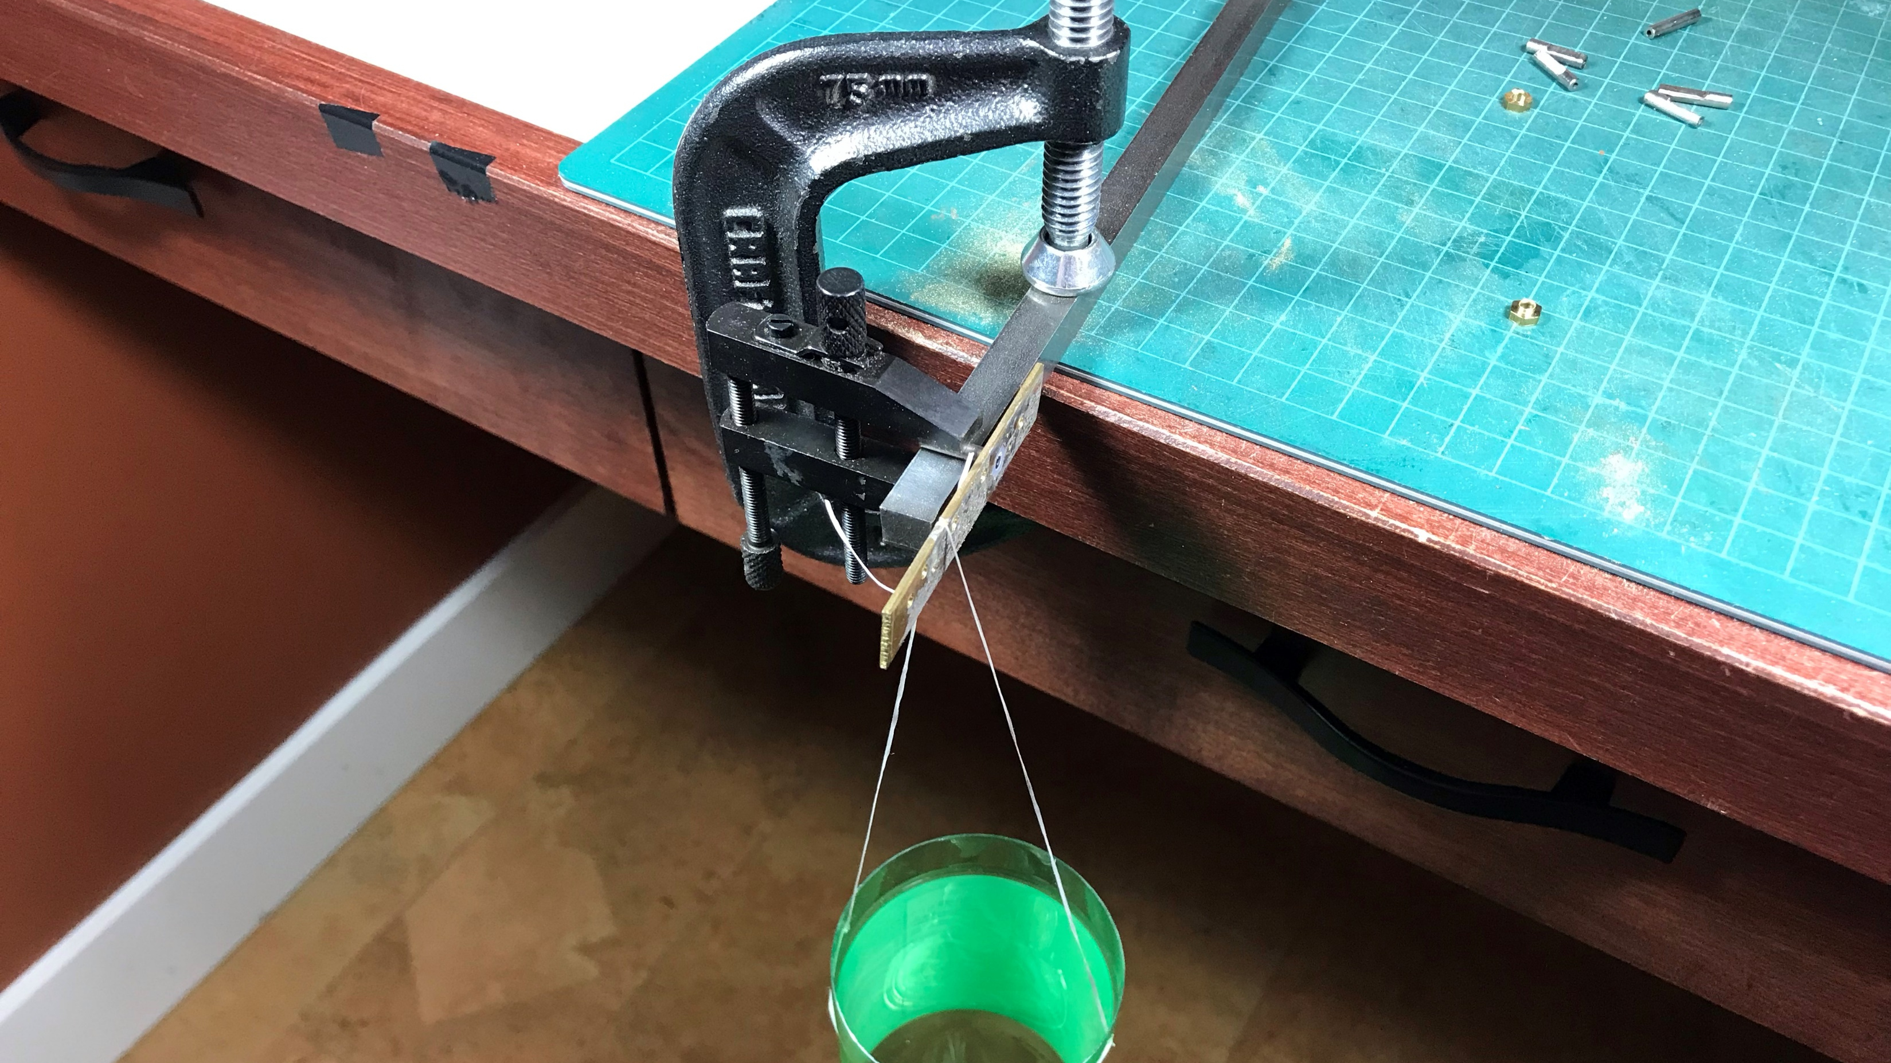

Slide 13
Wheel-Axle Adhesion
Interference fit
.008” key
.029” key
Capillary CA or Loctite
Pre-assembly CA
Solder
28:1
120:1

Slide 14
Split Axle Adhesion
Bad epoxy mix
Heated joint
D-shaped core
Plain core
.029” key
28:1
120:1

Slide 15
